Slide 1
Defense Capability Management
3D Asset Model
Niek Freriks
15-Sep-2021

Slide 2

Goal

Slide 3
Goal
Of the extension
Hotspot's data coming from worksheet
Worksheets respond on click
Flexible extension
No code implementation
Configurable 3D model

Slide 4
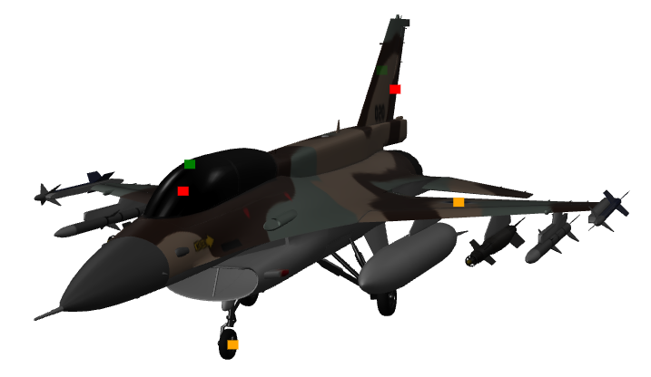
Goal
Example Workbook
Worksheet
Worksheet
Worksheet(s)
Interaction
Summary Worksheet
Provides Color and Tooltip Data

Slide 5

So Far

Slide 6
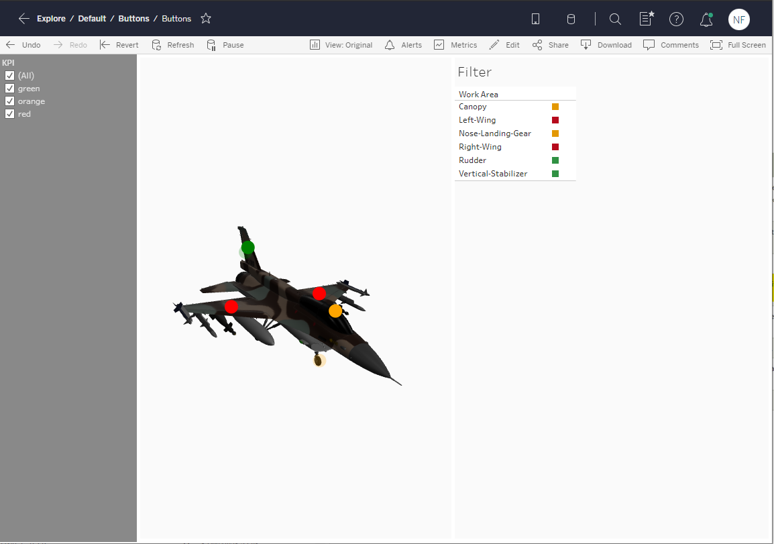
So far
It’s a start
Data comes from hidden sheet
KPIs can be filtered out from the 3d model

Slide 7
So far
files
JavaScript
HTML
buttons.js
index.html
Tableau.extensions.1.latest.min.js
model-viewer.min.js
TREX
buttons.trex
CSS
Assets
style.css
F-16D.gltf
https://github.com/niek-ilias/niek-ilias.github.io

Slide 8

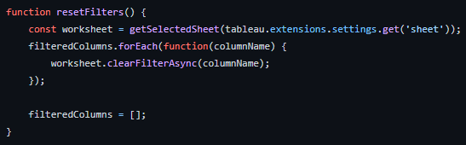
So far
Next step
Use the hotspots in the model-viewer to interact with other sheets
worksheet.applyFilterAsync(fieldName, columnDomain, tableau.FilterUpdateType.Replace)
worksheet.clearFilterAsync(columnName)
Add configuration to enable no-code implementation

Slide 9

DATA

Slide 10
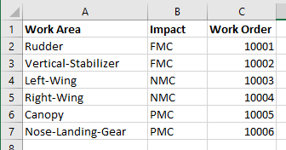
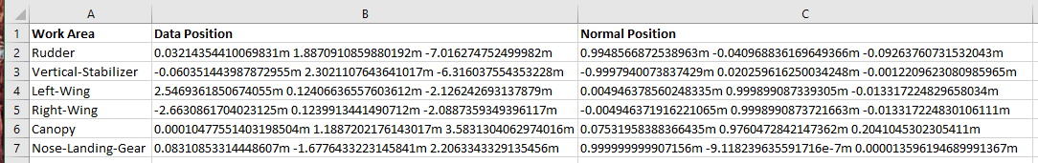
DAta
Excel File
Fact
Dimensions
Note: this is a representation of the data and not the actual ILIAS format

Slide 11
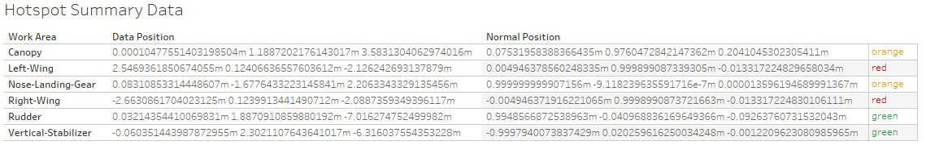
DAta
Tableau sheet
Worksheet name: Hotspots
Limit to 1 3D model at a time
3D Model
KPI
Tooltip
F-16D.gltf
Description….
F-16D.gltf
Description….
F-16D.gltf
Description….
F-16D.gltf
Description….
F-16D.gltf
Description….
F-16D.gltf
Description….

